Slide 1
Development of Shelter Navigation with Considering Three Cs in the Corona Age
Hiroto Nakada
(Conference)

Slide 2
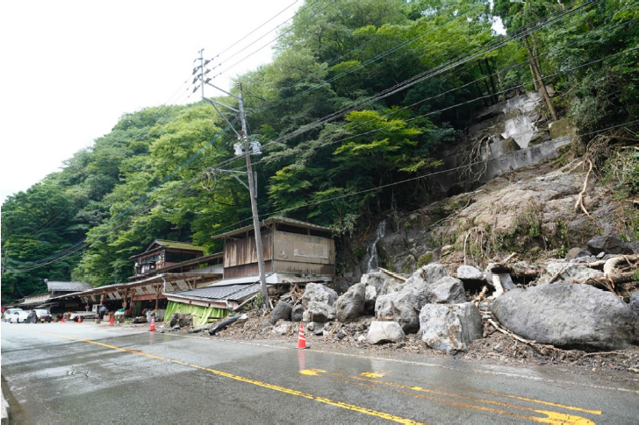
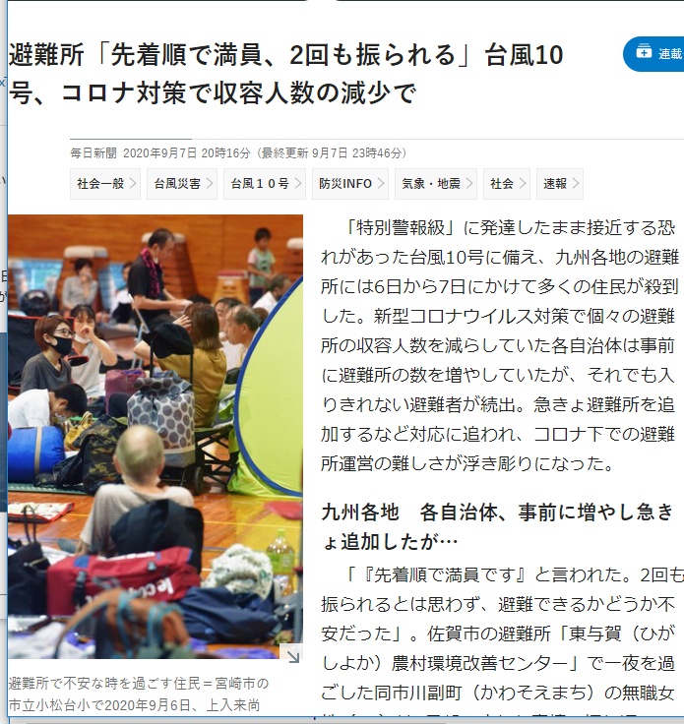
Disaster Evacuation in Japan
People fail to evacuate in disaster
Lack of awareness & preparedness
Normalcy bias: “My house may be safe”
Unaware of when/where to evacuate
COVID-19 makes things worse
Citizens hesitate to evacuate
Afraid of the risk of infection
The capacity of shelter is limited
Government wants to avoid 3C
Shelters may refuse to accept people*
How should the disaster evacuation in the corona age be?
*Source: CWMD, Kumamoto Univ. 2020-07
*Source: Mainichi Shinbun 2020-09-07

Slide 3
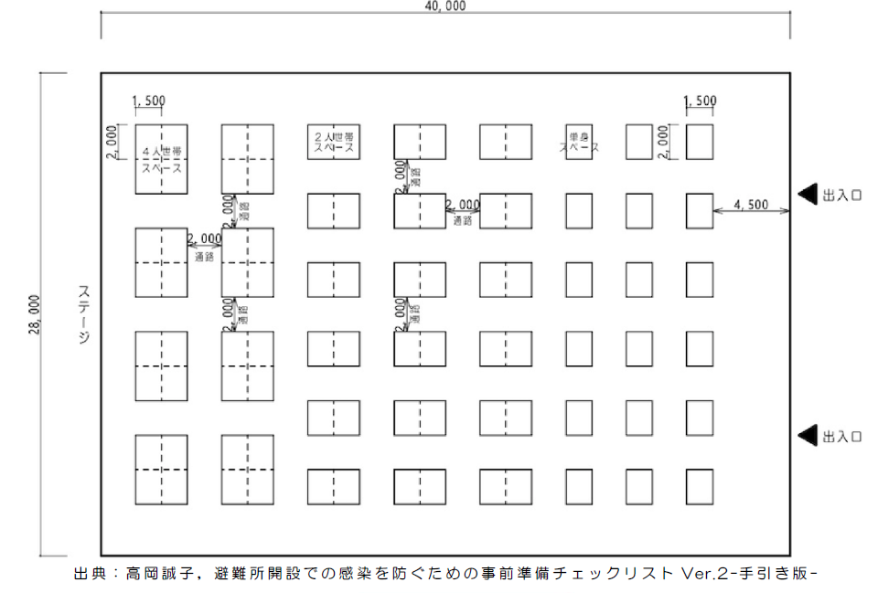
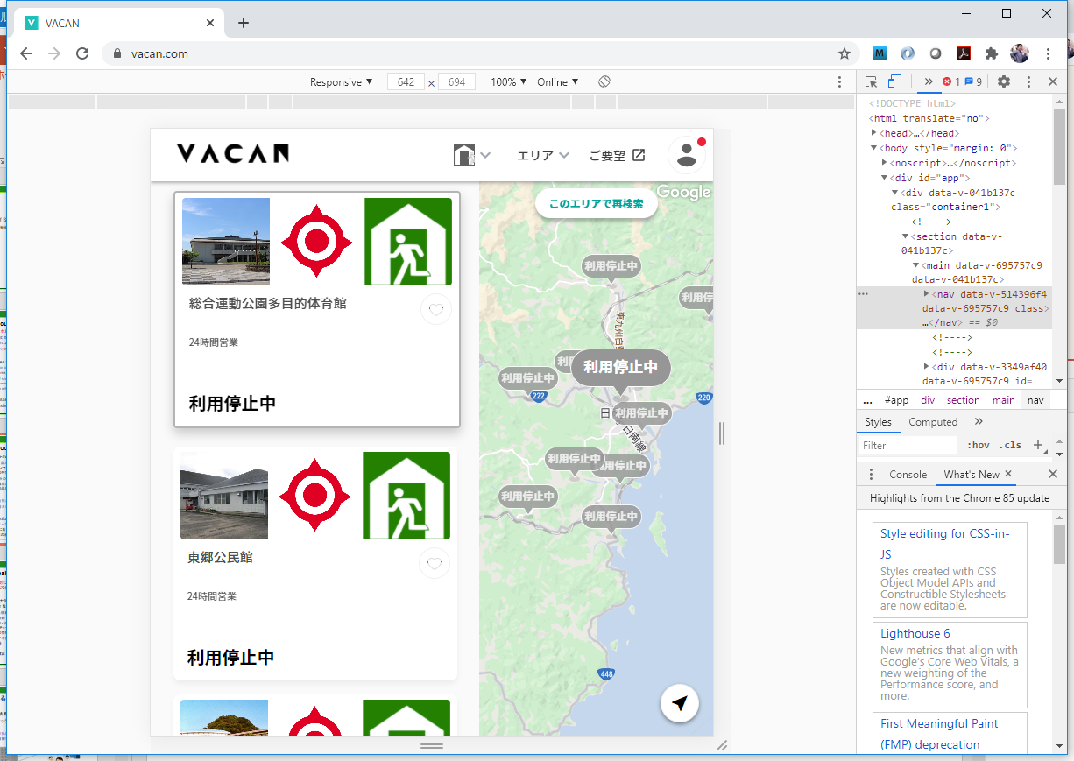



Struggles of Local Governments
Develop corona-aware evacuation shelters
New guideline avoiding 3Cs in shelters
Sparse Layout & Floor Plan, Thermometry, Health Inquiry, Phone-based Alert, Safety Confirmation…
Online Delivery of Congestion Information
Smartphone App “VACAN” (Nichinan-City, Miyazaki)
Staff manually update the status on site
Completely relying on local government
New policies add heavy workload to staff
Lack of scalability for # of citizens / shelters
Research Question
In disasters in corona age, how can citizens find appropriate shelters by themselves without relying on governmental staff?

Slide 4


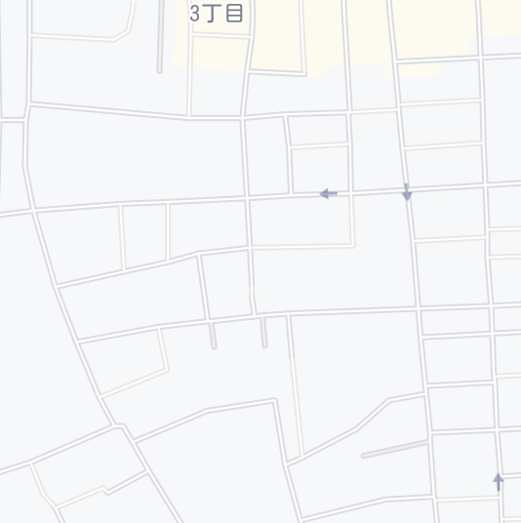




Research Goal and Approach
Research Goal
Achieve safe and smooth evacuation avoiding 3Cs in shelters by self-help effort of citizens
Approach
Develop Shelter Navi – A smartphone-based navigation app.
Cloud server manages location & status of shelters
Citizens search shelters with the status with app
As citizens “check in”, the system updates the status
search
Shelter name | Address | Max # of families | Current status
A high school | XX town 1-2 | 50 | 48
B element. school | YY town 4-5 | 30 | 20
C comm. center | YY town 11-4 | 10 | 6
D sports center | WW town 8-9 | 125 | 22
A
check-in
B
C
+1
D

Slide 5


Citizen’s Use Cases
C1: Register household information
Name, home address, email, phone, # of families
C2: Search shelters
System visualizes shelters with congestion status on a map
With the map, citizen searches a shelter to evacuate
C3: Check-in at shelter
Citizen moves to the shelter, and presses “Check-In” button
System records the check-in, and updates the status of the shelter
Crowded
Disaster Alert
NAME:
Hiroto Nakata
ADDRESS:
X town 33-2
EMAIL:
hiroto@aaa.jp
PHONE:
079-9123-4567
# of FAMILY: 4
2020-10-03 12:00
Muronani Toshiki
Check in at
D Sports Center
check in
2020-10-03 12:05
Nakada Hiroto
Check in at
D Sports Center

Slide 6

Local Government’s Use Cases
G1: Register shelter information
Shelter name, address, lat, lng, capacity, description
G2: Check status
System shows the current status of every shelter
Staff checks if the status matches the real situation
G3: Confirm safety of particular citizen
System shows the list of evacuated citizens at every shelter
Staff confirms the safety of any particular citizen
Shelter name | Address | Max # of families | Current status
A high school | XX town 1-2 | 50 | 48
B element. school | YY town 4-5 | 30 | 20
C comm. center | YY town 11-4 | 10 | 6
D sports center | WW town 8-9 | 125 | 22
Disaster Alert
SHELTER NAME:
A High School
ADDRESS:
XX town 1-2
Lat-Lng: 134.6867,34.8434 Max # of families:
50
List of Citizens D sports Center
-----------------------------
NAME CHECK-IN #
---------------------------------
Nakada H. 12:00 5
Murotani T. 12:05 4
：
Crowded

Slide 7


System Architecture
Implement as Web Application
Server Side: Logic, API, Database
Client Side: Browser App
JS
HTML
Shelter Navi
Logic
JS
HTML
Citizen API
Government API
Shelter Navi
DB
JS
Government
HTML
Google
Maps
Citizens

Slide 8
System Architecture
JS
HTML
ShelterNavi
System
JS
HTML
Citizen API
Government API
Shelter Navi
DB
JS
Government
HTML
Google
Maps
Citizens

Slide 9
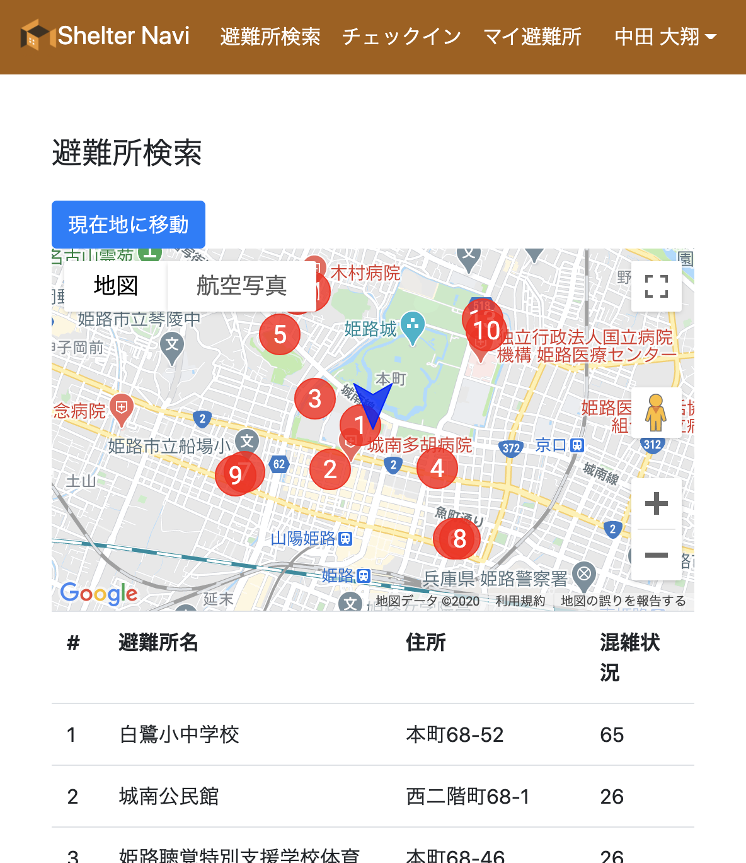
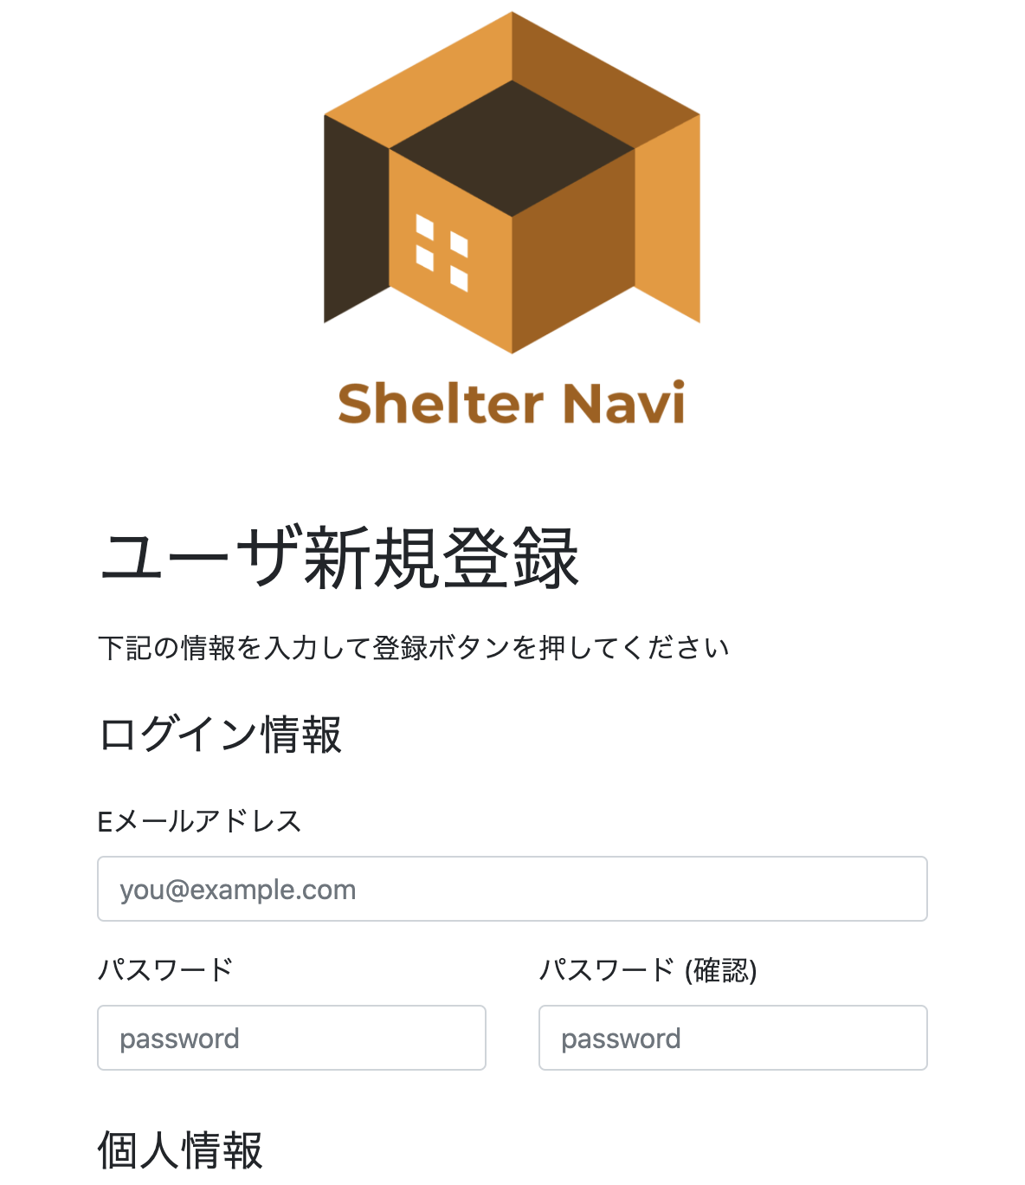
実装（デモンストレーション）
利用した技術
クライアントサイド：HTML5,JavaScript,Bootstrap
サーバーサイド：Java,SpringBoot,MySQL,
地図サービス：GoogleMaps JavaScript API

Slide 10
避難所情報のテーブル
避難所ID
施設名
住所、緯度・経度
収容可能人数
至近距離の避難所検索
現在位置から半径dkmの避難所を提示
フロント側で現在位置の緯度・経度を取得
半径を指定してデータ呼び出し
避難所の収容率の算出
チェックインによって受け入れた人数をカウント
現在の収容人数 / 避難所の収容可能人数で算出
dkm

Slide 11
Discussion
避難所の密の形成を避けるナビゲーション『Shelter Navi』
このアプリの特長
自治体職員の避難所確認・混雑状況の手入力が不要
住民の安否確認が可能
今後の課題
誰が避難所の情報を入力するのか
高齢者などアプリに扱いに不慣れな人には使いづらいかも？
携帯電話網が機能していないと使えない
追加機能の実装
避難所が満員となった際、避難する親戚・知人宅が管理できる機能
自治体の災害情報がアプリ上確認できる機能
アプリの実証実験・評価

Slide 12
謝辞
神戸大学大学院システム情報学研究科
中村 匡秀 先生
室谷 敏生 様
JSTグローバルサイエンスキャンパス ROOTプログラム

Slide 13
Thank you for listening !

Slide 14

5.アプローチ
『Shelter Navi』を開発する
自宅周辺の避難所を地図上に表示するとともに、避難所の混雑状況をリアルタイムで確認できるアプリケーション

Slide 15
6.提案手法
機能
避難所の混雑状況の確認
リアルタイムの情報を確認可能
地図上に表示
チェックイン・チェックアウト機能
住民がどこに避難したかが確認可能
これにより避難所の収容率を計算（職員の入力作業不要）
私的な避難所（Private Shelter)の登録
新たな避難様式に対応

Slide 16
評価

